Slide 1

“Real Time Network Intrusion Detection using Machine Learning Technique ”
TEAM MEMBERS
ADRIAN DSOUZA - A830
VEDANT LANJEWAR - A860
ABHISHEK MAHAKAL -A863
Under the guidance of
Prof. S. P. Khachane

Slide 2
Real Time Network Intrusion Detection using Machine Learning Technique.
Internet
Internet Service Providers
Hackers & Snoopers
Governments

Slide 3

“One Single Vulnerability is all an attacker needs.”
Window Snyder,
Chief Security Officer, Fastly.

Slide 4
BE-A
Group No: - 14

Slide 5
TEAM MEMBERS
ADRIAN DSOUZA - A830
VEDANT LANJEWAR - A860
ABHISHEK MAHAKAL -A863

Slide 6

Content
Introduction
Features
Literature Review
Problem Statement
Existing System
Proposed System
System Architecture
Algorithms Used
Hardware and Software requirements
References

Slide 7
Introduction
Prevention is better than cure ~ Our motto.
IDS are systems designed to analyse and prevent Risk or Attacks
With growing Technologies the vulnerabilities our system faces increases Day by Day
IDS with the help of Machine Learning / Deep Learning and Artificial Intelligence has the power to overcome this.
We believe our project has the potential to be carried on as a solution that can be easily and readily deployed in tomorrow's market.
We aim to prevent and safeguard our resources from unlawful acts and propaganda.

Slide 8
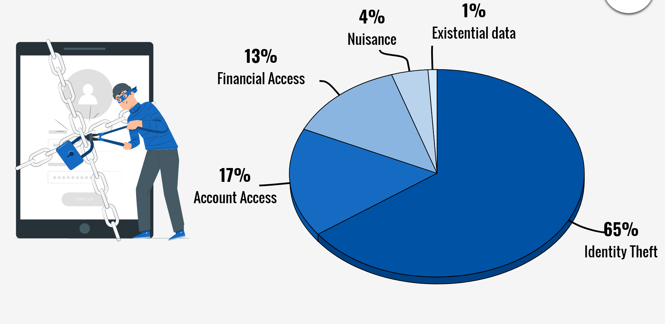
Why we need Intrusion Detection System?
DDoS attacks became more prevalent in 2020, with the NETSCOUT Threat Intelligence report seeing 4.83 million attacks in the first half of the year.

Slide 9

For whom is this system
Big companies dealing with loads and loads of data and public information
Schools, colleges, universities holding sensitive student information. Competitive exams papers all on their servers
Healthcare systems
Banking and cryptocurrency sector
Private networks and crucial services

Slide 10
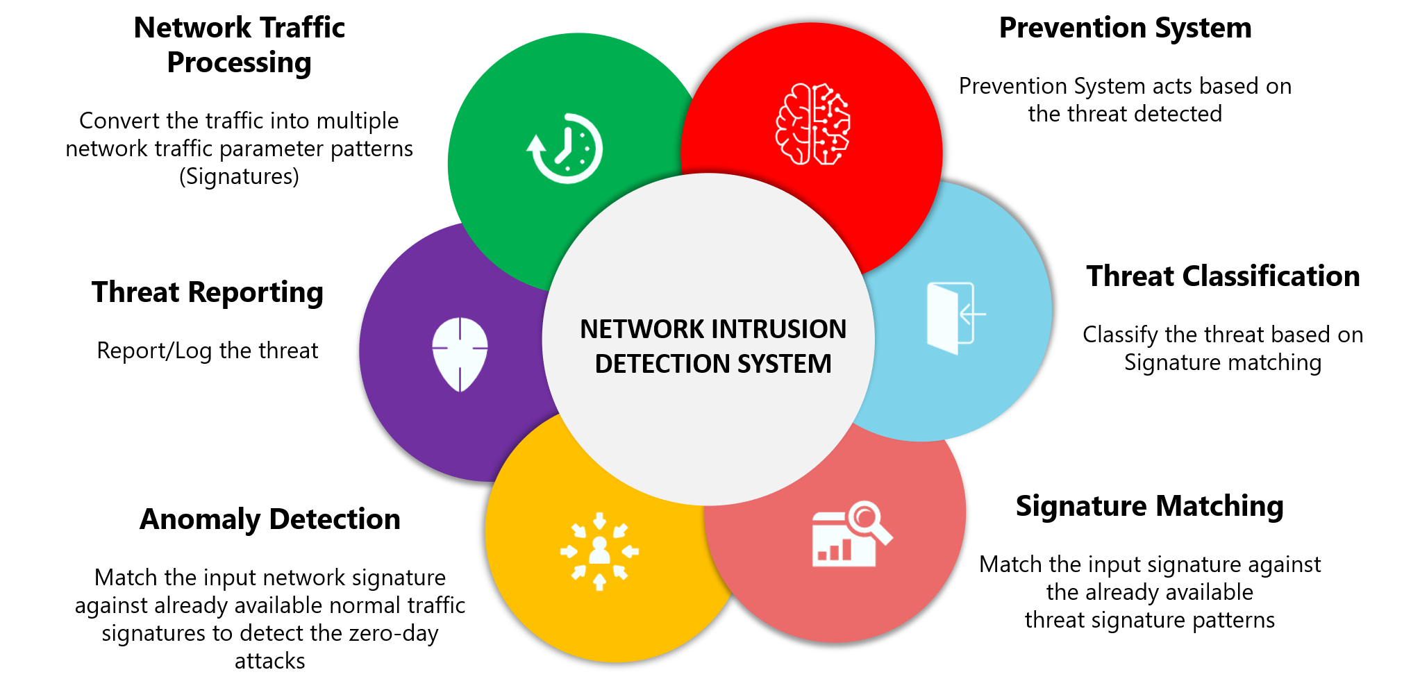
2. NETWORK INTRUSION DETECTION FEATURES

Slide 11
3. Literature Review
Author : Kazi Abu Taher, Billal Mohammed Yasin Jisan and Md. Mahbubur Rahman
Paper Title : Network Intrusion detection using Supervised Machine Learning with feature Selection
Year : 2019
Methodology :
Dataset- NSL-KDD
Algorithm - SVM and ANN
Feature selection techniques- Correlation based(Wrapper) and Chi-Square based(filter).
FINDINGS-
The ANN and wrapper feature selection outperformed all other models in classifying network traffic correctly with detection rate of 94.02%.
5. LIMITATIONS-
a. The intrusion detection system can only detect know attacks. Detecting new attack or zero-day attack still remain research topic due to the high false positive rate of the existing system.
2. Author : Yasir Hamid, V. R. Balasaraswathi, Ludovic Journaux and M. Sugumaran
Paper Title : Benchmark Datasets for Network Intrusion Detection: A Review
Year : 2018
Methodology :
Dataset-Full KDD99,Corrected KDD,10% KDD, UNSW, Caida, ADFA Windows, UNM Dataset
Algorithm- KNN
FINDINGS-
The best dataset for intrusion detection is NSL-KDD based on KNN-algorithm, reason being its even distribution of instances across various classes and minimal redundancy among the records.

Slide 12
3. Author : L.Dhanabal and Dr. S.P. Shantharajah
Paper Title : A Study on NSL-KDD Dataset for Intrusion Detection System Based on Classification Algorithms
Year : 2015
Methodology :
Dataset- NSL-KDD
FINDINGS-
There are 42 features in the dataset and the attack classes in this dataset are grouped into 4 classes
Dos 2) Probing 3)U2R 4)R2L
Most of attacks launched by the attackers use the TCP protocol suite. The transparency and ease of use of TCP protocol is exploited by attackers to launch network based attacks on the victim computers.
3. FUTURE SCOPE-
a. Conduct an exploration on the possibility of employing optimizing techniques to develop an intrusion detection model having a better accuracy rate.
4. Author : Manjula C. Belavagi and Balachandra Muniyal
Paper Title : Performance Evaluation of Supervised Machine Learning Algorithms for Intrusion Detection
Year : 2016
Methodology :
Dataset- NSL-KDD
Algorithms- Logistic Regression, Gaussian Naive Bayes, Support Vector Machine and Random forest.
Performance measures- Precision, Recall, F1-score, Accuracy
FINDINGS-
Random forest Classifier outperforms other classifiers for considered data-set and parameters and has given the accuracy of 99%
5. FUTURE SCOPE-
a. The work can be extended by considering the classifiers for multiclass classification and considering only important
attributes for the intrusion detection.

Slide 13
4. Problem Statement
Communication system plays an inevitable role in common man’s daily life. Computer networks are effectively used for business data processing, education and learning collaboration, widespread data acquisition and entertainment.
With the widespread usage of internet and increasing access to online content, cyber crime is also increasing at an alarming rate.
This make the requirement for the computer network to be continuously monitored and protected.
Thus needing a system that can effectively detect, prevent and alert us.

Slide 14
5. Existing System
Most of the existing system make use of Anomaly based Network Network Intrusion Detection techniques.
In anomaly detection method, decisions are made based on network normal behavior or features.The basic approach is to use machine learning to create a model of trustworthy activity, and then compare new behavior against this model
But since it is difficult to distinguish the boundary between normal and abnormal behavior, it has high false alarm rate.
The major limitation of the current system is the high time consumption in processing the data and high false alarm rate.
The dataset used by this technique has around 1,074,992 single connection vectors each of which contains 42 features and is labeled as either normal or an attack.

Slide 15
6. Proposed System
The proposed model consists of using learning algorithms such as Support Vector Machine, Random Forest, Naive Bayes, Decision Tree and Logistic Regression.
The main aim behind this proposed model is to increase the accuracy of the system which the current system is wanting.
Using packet sniffer, the common features are selected which will help to decrease the computational time.
In order to improve the accuracy, we will also try to make use of hybrid ML algorithms to achieve the goal.
There will be 2 classes : Normal and Abnormal. Abnormal would be further classified into DoS, Probe, U2R, R2L attacks with increased accuracy.

Slide 16
7. System architecture
ANALYSIS
NETWORK TRAFFIC
INTRUSION DETECTION
ALERT GENERATION
INPUT
OUTPUT
DATA PREPROCESSING
FEATURE SELECTION
ML CLASSIFIERS
DETECTION MODEL
DECISION MAKING
ATTACK RECOGNITION

Slide 17
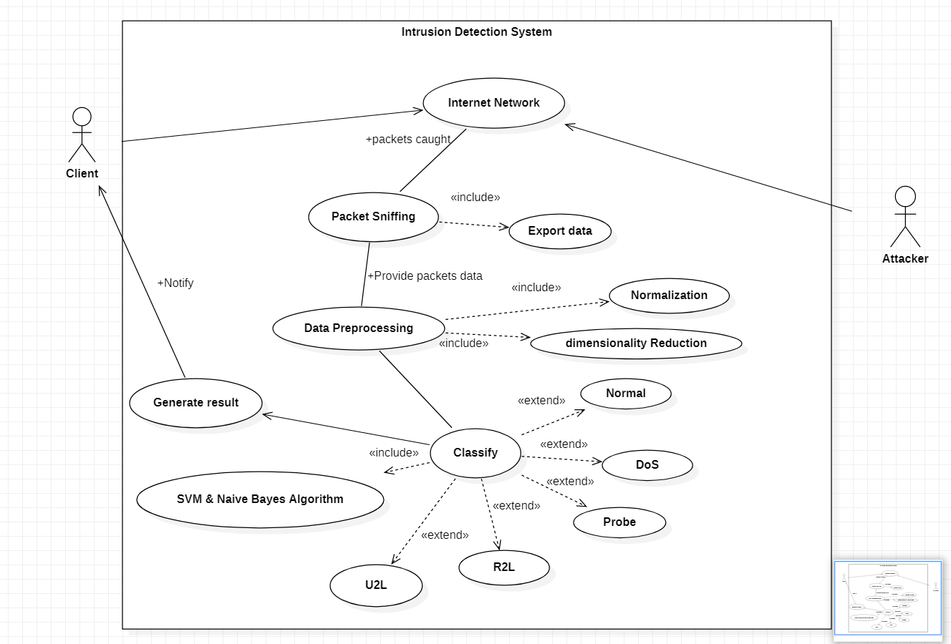

8. System Design
Use Case Diagram

Slide 18
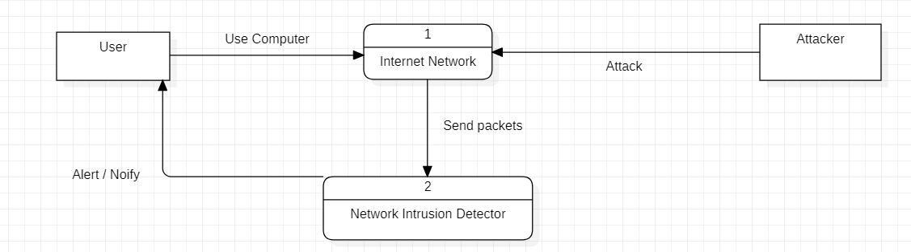
2. Data Flow diagram
level 0

Slide 19
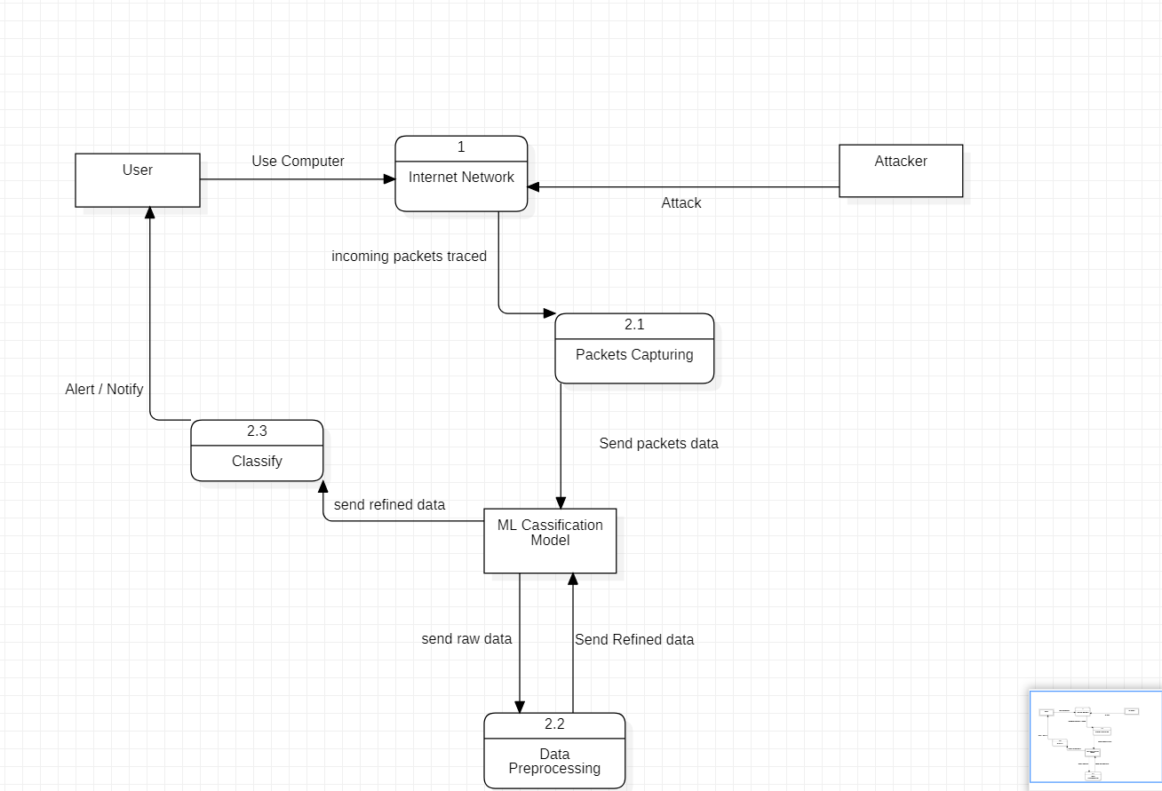
level 1
level 1

Slide 20
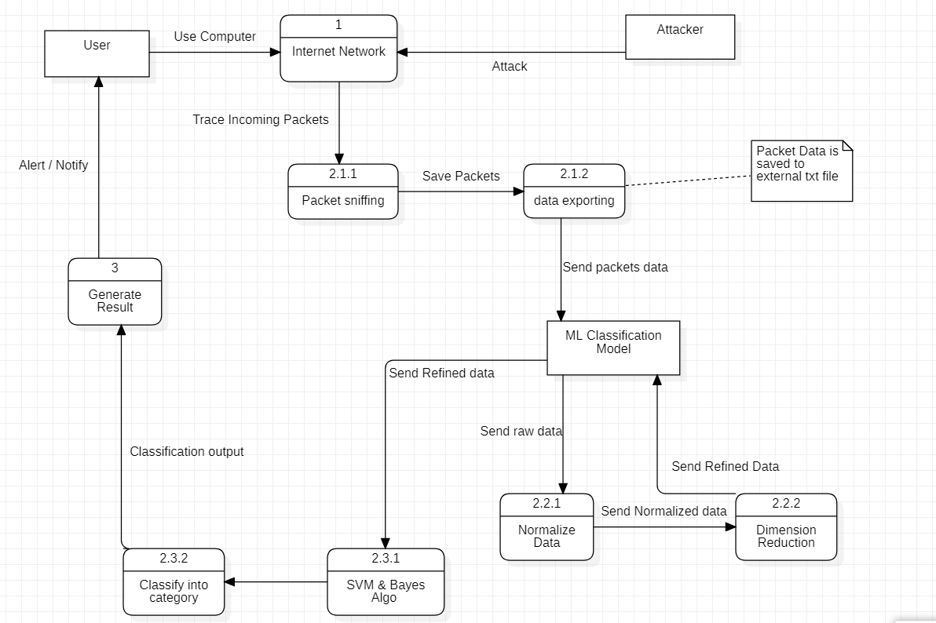

Level 2 level 2
Internet

Slide 21

9.Libraries
PANDAS
NUMPY
MATPLOTLIB
SEABORN
SKLEARN
PYSHARK

Slide 22
10. Algorithms We Applied
SVM ( Support Vector Machine)
Random forest ( Ensemble learning)
Naive Bayes
Decision Tree
Logistic Regression

Slide 23
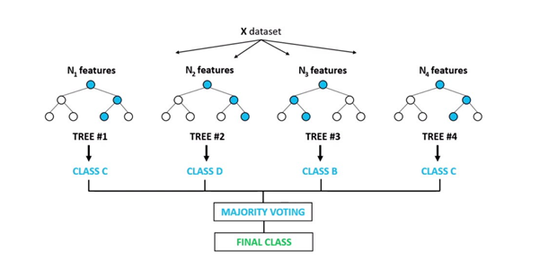
Random Forest Regressor
MODELS | ACCURACY | RMS | F1 SCORE | RECALL | PRECISION
RANDOM FOREST | 0.9911 | 0.094 | 0.9917 | 0.9944 | 0.9889

Slide 24
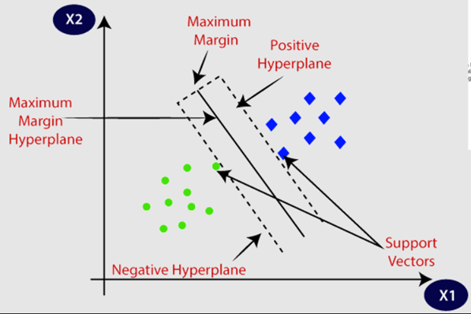
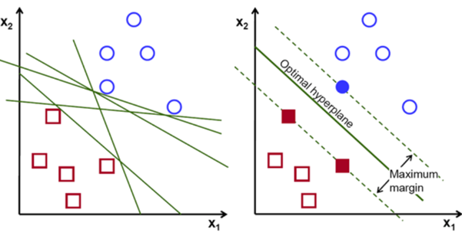
Support Vector Machine ( SVM)
1
2
MODELS | ACCURACY | RMS | F1 SCORE | RECALL | PRECISION
SVM | 0.6159 | 0.6196 | 0.4602 | 0.3067 | 0.9217

Slide 25

D.Naive Bayes
MODELS | ACCURACY | RMS | F1 SCORE | RECALL | PRECISION
NAIVE BAYES | 0.874 | 0.3548 | 0.8897 | 0.9515 | 0.8354

Slide 26

Decision Tree
MODELS | ACCURACY | RMS | F1 SCORE | RECALL | PRECISION
DECISION TREE | 0.9911 | 0.094 | 0.9917 | 0.9924 | 0.9909

Slide 27
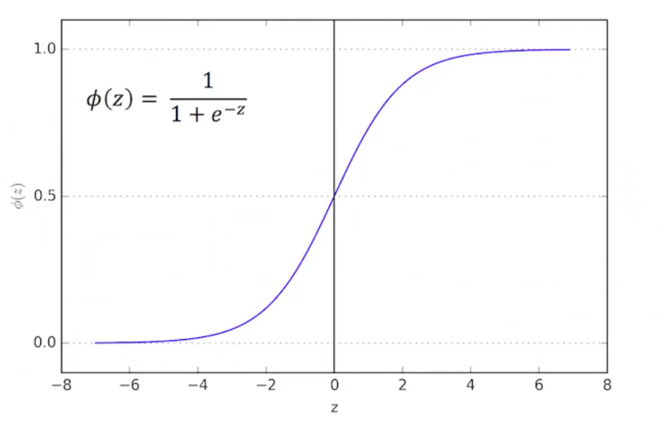
Logistic Regression
MODELS | ACCURACY | RMS | F1 SCORE | RECALL | PRECISION
LOGISTIC REGRESSION | 0.9085 | 0.3025 | 0.9156 | 0.9293 | 0.9023

Slide 28

Comparing the Features that could be extracted from pyshark with NSL-KDD Dataset
NSL-KDD features : 41
Common features found are: 7
protocol
land
urgent
count
srv count
dst_host_count
Dst_host_srv_count

Slide 29
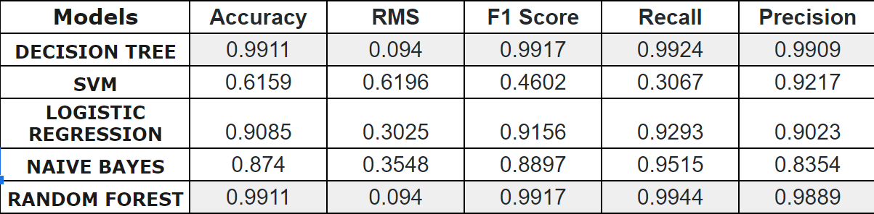

Training Different ML models wrt the 7 common features

Slide 30

Real Time Based Network Intrusion Detection System.
Using pyshark library to extract data from real time packets by sniffing on the incoming traffic.
Creating our own real time data set
Current features incorporated = 7
Show IP address of incoming packets. To identify sender.

Slide 31
RECENT
CHANGES

Slide 32
Software and Libraries used
Software used:
Flask
MongoDB
Studio 3T
Libraries Used:
uuid
pbkdf2_sha256
wraps
psutil
get_mac_address
pymongo

Slide 33
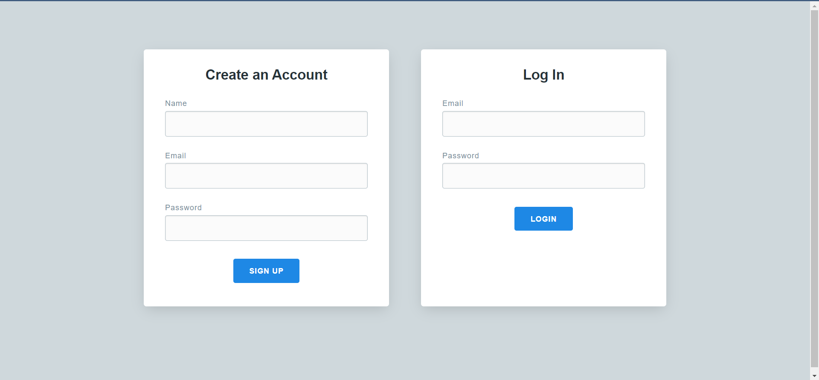
User Login

Slide 34
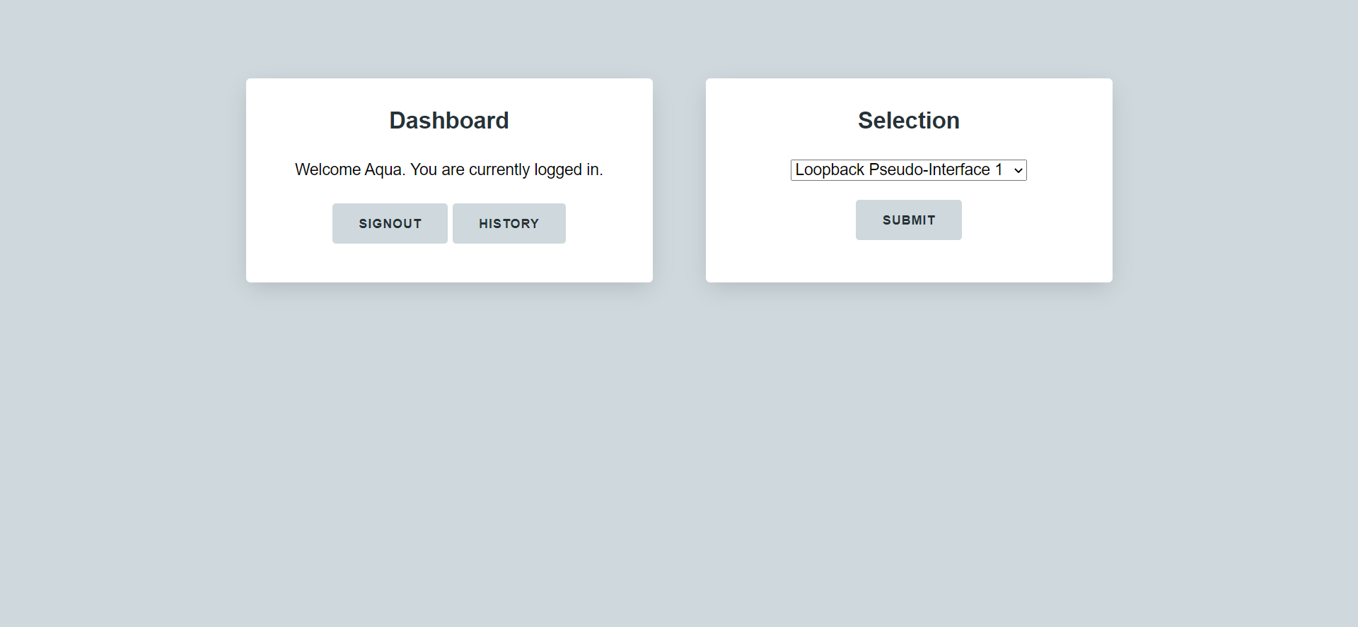
Dashboard

Slide 35
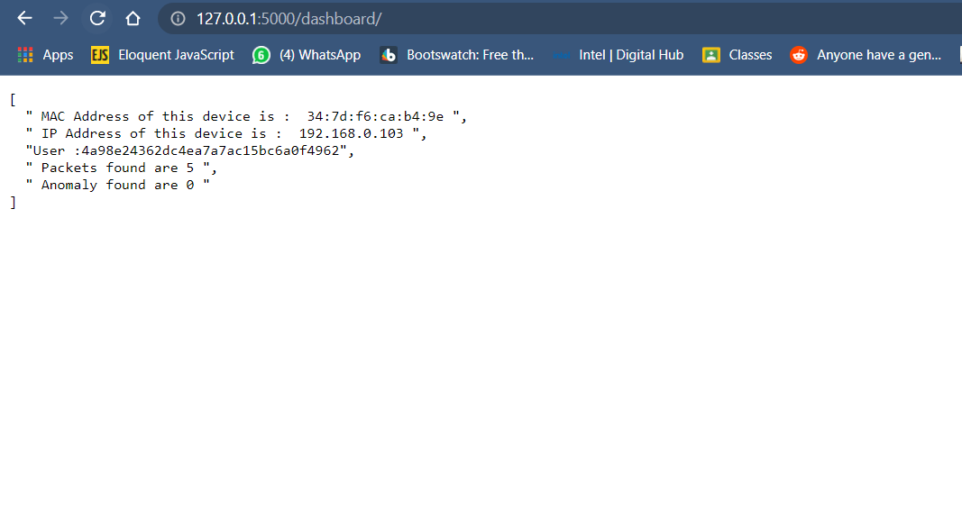
Scan Results

Slide 36
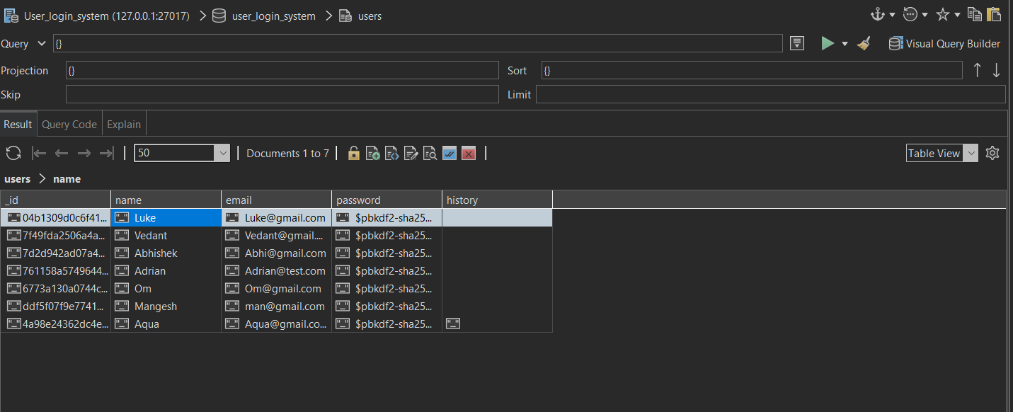
Snap of the database

Slide 37
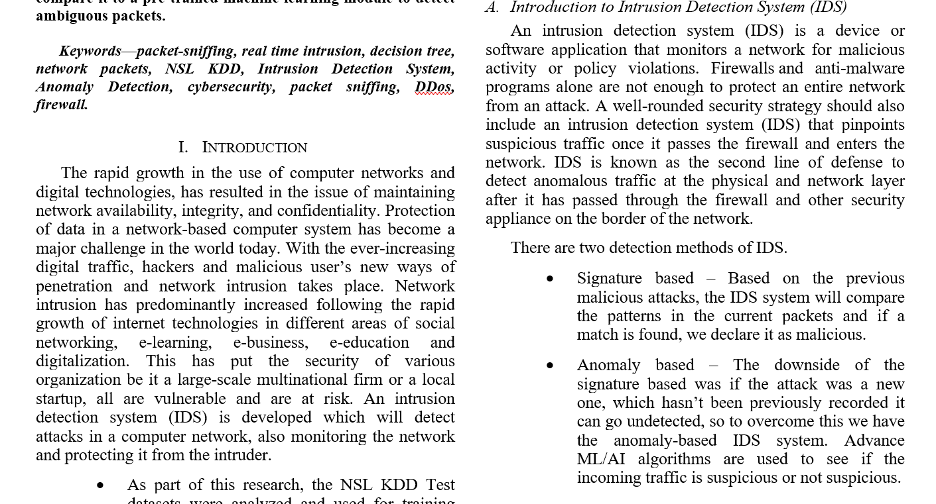
Paper Presentation

Slide 38
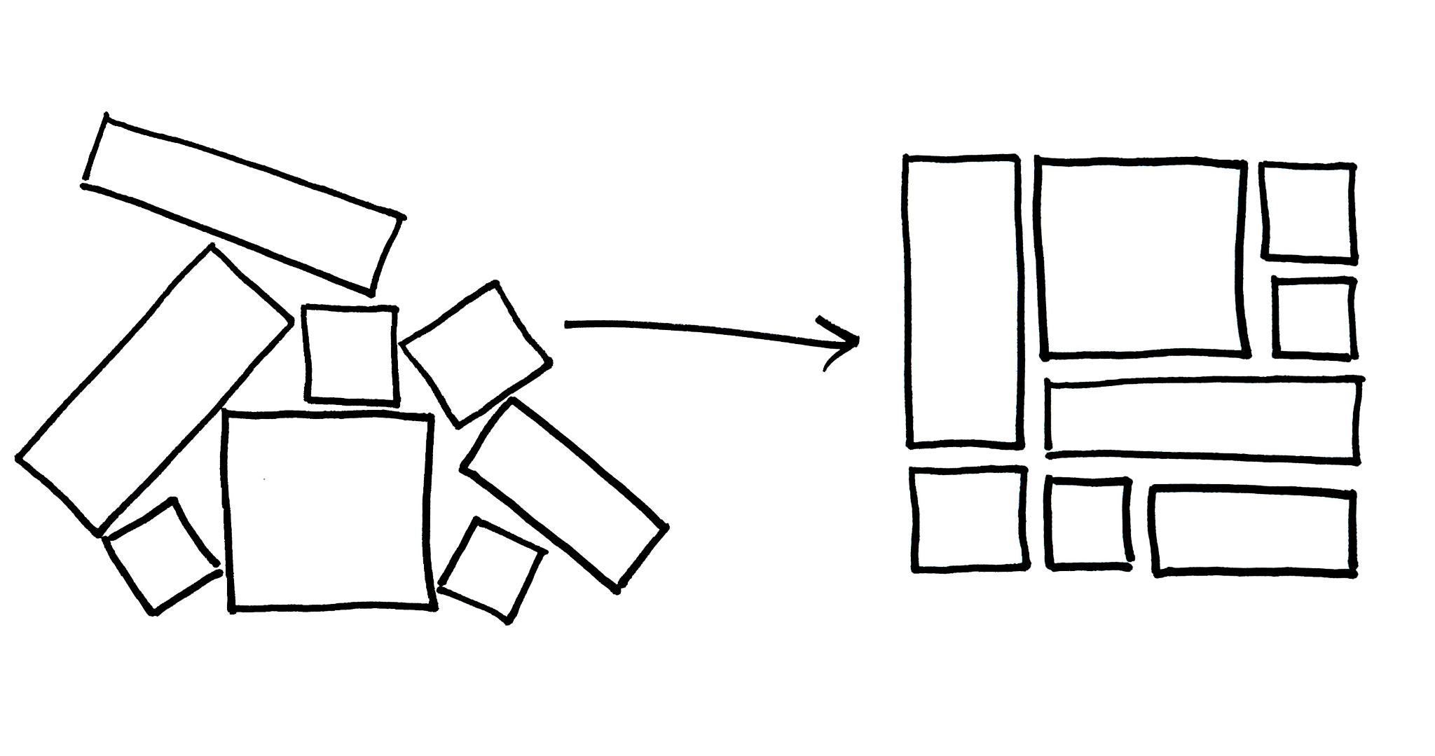
Implementation

Slide 39
Future Work

Slide 40
Block malicious incoming IP packets from the list by fetching from database.
Analytic dashboard to show types and number of attacks.
Complete and publish research paper.

Slide 41
11. Hardware and Software Requirements
HARDWARE
64-bit 2.6 GHz Intel core i5 CPU
8 GB RAM
Windows 7 environment
SOFTWARE
Jupiter Lab (Python)
Python
MongoDB
Flask
Studio 3T

Slide 42
12. References
L. Dhanabal and S. P. Shantharajah, “A study on NSL-KDD dataset for intrusion detection system based on classification algorithms,” International Journal of Advanced Research in Computer and Communication Engineering.
Kazi Abu Taher,Billal Mohammed Yasin Jisan and Md. Mahbubur Rahman,
“Network Intrusion Detection using Supervised Machine Learning Technique
with Feature Selection,”International Conference on Robotics,Electrical
and Signal Processing Techniques (ICREST)
MACHINE M. C. Belavagi and B. Muniyal, “Performance evaluation of supervised
machine learning algorithms for intrusion
detection, ” Procedia Computer Science.
Yasir Hamid, V. R. Balasaraswathi, Ludovic Journaux
and M. Sugumaran, “Benchmark Datasets for Network
Intrusion Detection: A Review”,International Journal
of Network Security, Vol.20, No.4, PP.645-654, July 2018

Slide 43
Reference Link
https://github.com/KimiNewt/pyshark
https://pypi.org/project/pyshark/

Slide 44

QUESTIONS ?

Slide 45
THANK YOU !
“And Remember
Prevention is Better than Cure”

